Slide 1
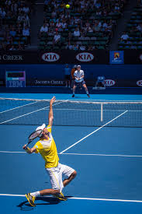
ATP Tennis analysis by india flores
Demonstrates data cleaning, SQL analysis in BigQuery, and Tableau visualization

Slide 2


objectives
Analyze trends in the data by answering:
How many ATP matches are played on each surface type?
Which players win the most matches on each surface?
Which surface produces the most physically demanding matches?
How many matches does each player play on each surface?

Slide 3
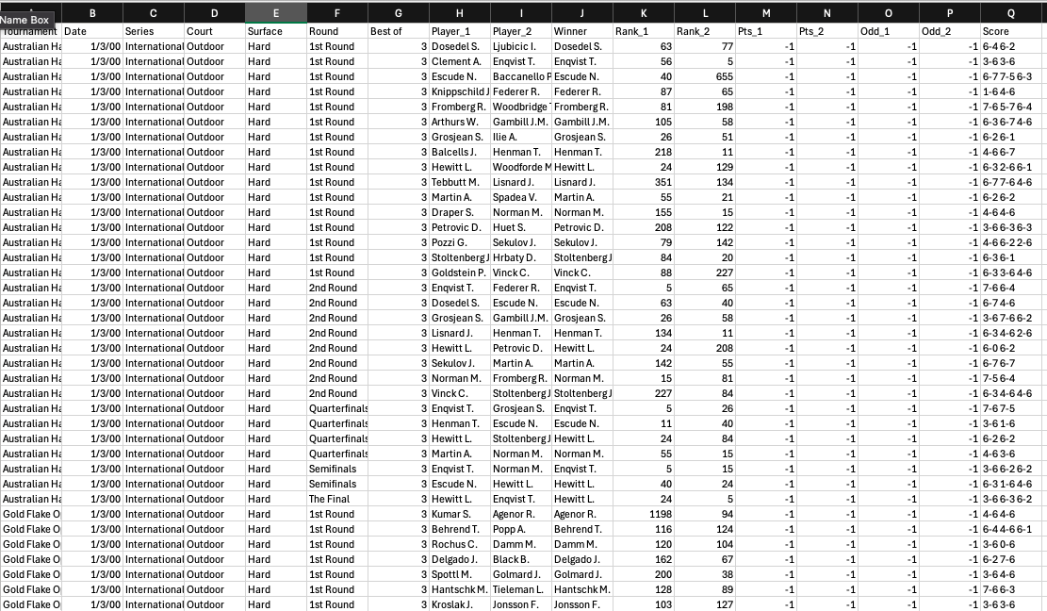
ABOUT THE DATA
Includes 66,682 rows with information on tournaments, surface type, players, winners, and scores
Downloaded from Kaggle in a CSV file to Excel
Cleaned the data by splitting score fields into separate columns, standardizing surface names, converting dates to a consistent format, and removing duplicate records
Analysis focuses on main-draw ATP matches from 2000–2025
Full dataset: ATP Tennis 2000-2025

Slide 4
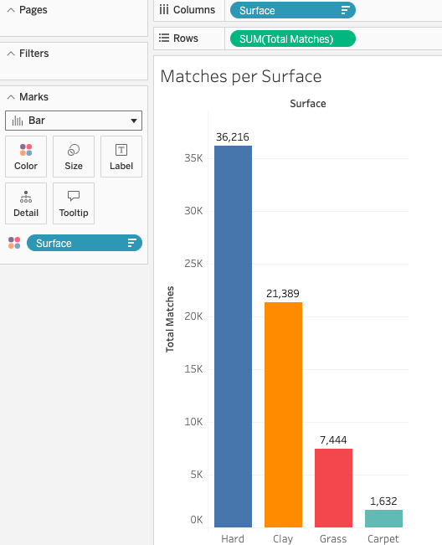

TOTAL MATCHES PER SURFACE
Used COUNT(*) grouped by surface to calculate the total number of matches played on each surface
Hard courts had the most matches played, carpet courts had the least
Hard courts dominate ATP scheduling, reflecting their prevalence in professional tournaments

Slide 5
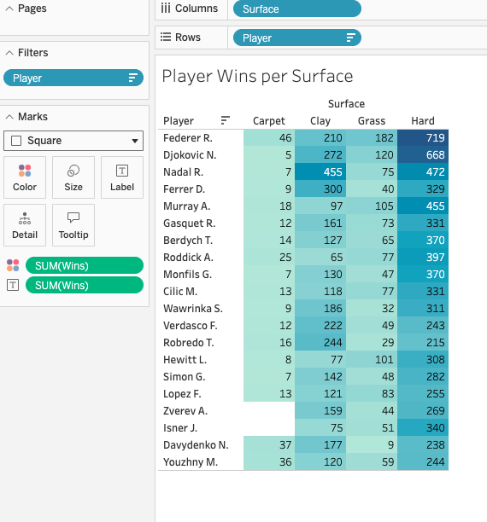
PLayer success by surface
Highlighted top 20 performers and their most successful surface type by using color and labels in Tableau
Federer R. had the most success on hard surface courts with 719 wins
Rafael Nadal demonstrated exceptional dominance on clay courts, leading all players with 455 wins

Slide 6
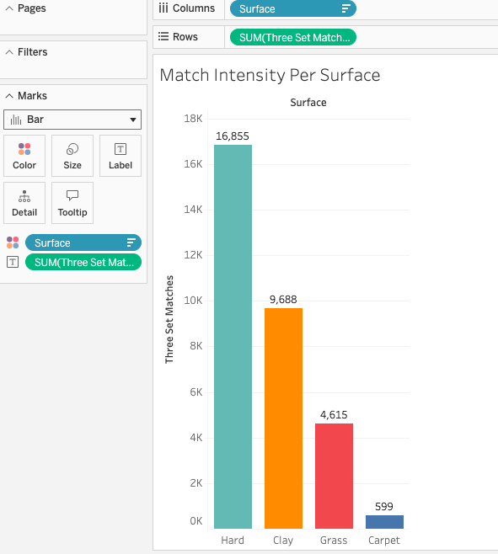
Match intensity per surface
Used SQL to identify matches that required a third set as a signal for match intensity
16,855 out of 36,216 hard-court matches required a third set
Only 599 games played on carpet had a 3rd set

Slide 7
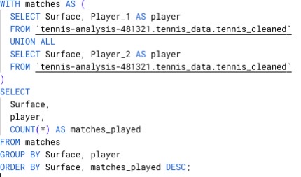
Player workload per surface
Created a CTE that unions player_1 and player_2 to account for total match participation per player
Referenced the CTE to find how many matches each player played on each surface type
This approach ensures each match contributes equally to player workload regardless of match outcome

Slide 8

INSIGHTS
Surface Distribution
Hard courts account for the majority of ATP matches, followed by clay and grass, reflecting both tournament scheduling and surface availability on tour.
2. Player Specialization
Player performance varies significantly by surface, with certain players demonstrating clear surface specialization rather than uniform success across all surfaces.
3. Match Intensity
Clay-court matches show a higher likelihood of extending to a third set, suggesting longer rallies and increased endurance demands compared to faster surfaces.
4. Player Workload
Players accumulate substantially more matches on hard courts, while select players show concentrated participation on specific surfaces, reinforcing strategic surface preferences.

Slide 9

LIMITATIONS AND NEXT STEPS
Carpet matches represent a small sample size and may limit generalizability
Match intensity measured only by third-set frequency
Future analysis could include win percentage by surface or average games per match

